Slide 1

Academic Session 2025-26
EVEN Semester Jan-Jun 2026
UNIVERSITY INSTITUTE OF ENGINEERING
AIT-CSE
B.E CSE
AIML/ 6th
SOFTWARE ENGINEERING
23CSH-374
Faculty Name : Dr Geeta Rani CUmail-ID : geeta.e15227@cumail.in
Designation : Associate Professor

Slide 2
Course Objectives
Understand fundamental software engineering processes, SDLC models, and requirement engineering techniques used in real-world projects.
Apply modeling concepts, design principles, and UML diagrams to represent system structures and behaviors effectively.
Analyze various software development, design, and testing strategies to determine their suitability for different project scenarios.
Evaluate software solutions and project management practices based on quality metrics, design principles, and testing outcomes.
Create structured requirement documents, UML models, test plans, and project management artifacts for medium-scale software systems.

Slide 3

16
Course Outcomes
CO No. | Statement
CO1 | Explain SDLC models, requirement principles, testing strategies, and project management concepts.
CO2 | Construct UML diagrams and apply design patterns to solve software design problems
CO3 | Compare SDLC models, testing strategies for different scenarios.
CO4 | Assess testing strategies, maintenance approaches, and project metrics to ensure software quality.
CO5 | Develop complete requirement specifications, design models, test plans, and project management documents (including Jira-based defect tracking) for real-world case studies

Slide 4
Suggestive Readings
Text Books:
Pressman, R. S., “Software Engineering: A Practitioner’s Approach,” McGraw Hill.
Ian Sommerville, “Software Engineering,” Pearson.
Reference Books:
Pankaj Jalote, “An Integrated Approach to Software Engineering,” Narosa.
Ghezzi, Jazayeri, Mandrioli, “Fundamentals of Software Engineering,” PHI.

Slide 5
Unit-I Syllabus
Unit-1 | Unit 1: Software Process and Requirement Engineering (15 hours)
Chapter 1.1 | Software Engineering: Introduction, SDLC, Agile vs Traditional models.
Chapter 1.2 | Requirement Engineering: Elicitation, Analysis, Specification, Validation.
Chapter 1.3 | Case Studies: Requirements in online payment systems.

Slide 6
Recap of Previous Lecture
Software engineering is an engineering discipline that is concerned with all aspects of software production.
Essential software product attributes are maintainability, dependability and security, efficiency and acceptability.
The high-level activities of specification, development, validation and evolution are part of all software processes.
The fundamental notions of software engineering are universally applicable to all types of system development.

Slide 7
Table of Contents
Software development life cycle (SDLC)
Goals
Objectives
Benefits
Stages of SDLC
SDLC Models
Summary

Slide 8
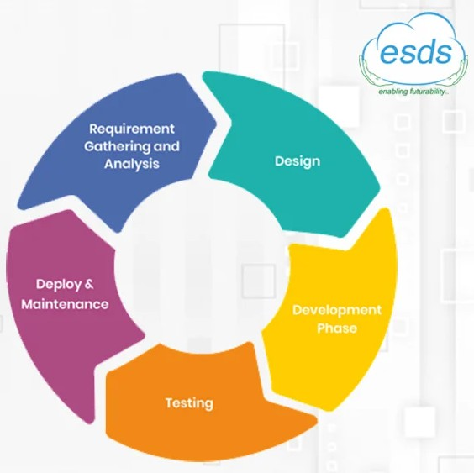
Software Development Life Cycle
SDLC stands for Software Development Life Cycle
A process for developing, designing, and maintaining a software project by ensuring that all the
Functionalities along with user requirements, objectives, and end goals are addressed
With SDLC, the software project’s quality and the overall software development process get enhanced.

Slide 9
Goals of SDLC
Efficiency
Build the system RIGHT: Do things RIGHT
▷ Windows 98: Crashed on launch
▷ Windows 10: Most popular OS
Lines of quality code produced per man-hour
Instances of quality support provided per man-week
Minimize Rework: Get it right the first time
Effectiveness
Build the RIGHT system: Do RIGHT things
▷ Iridium
▷ Tesla
Lines of quality code produced per dollar
Cost for every instance of support
Minimize Rework: Get it right the first time

Slide 10
Objectives of SDLC
Ensure that high quality systems are delivered
Built to contract (commitment)
Provide strong management controls over the projects
Efficiency
Effectiveness
Process Compliance
Cost Control
Customer Satisfaction
Maximize the productivity of the systems staff
Built by best practices

Slide 11
Benefits of Software Development Life Cycle
Address the goals and problems so that the project is implemented successfully
Project members cannot proceed ahead before completion & approval of the prior stages
Has necessary checks at each stage so that it is tested with precision before entering the installation stage
Project members can continue the software development process without incurring any complications
Optimal control with minimum problems, allowing the project members to run the project smoothly

Slide 12
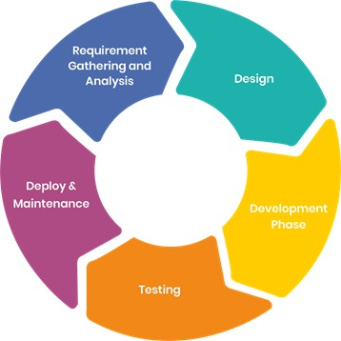
Stages of SDLC
Stages of SDLC
Phase 1: Requirement collection and analysis
Phase 2: Feasibility study
Phase 3: Design
Phase 4: Coding
Phase 5: Testing
Phase 6: Installation/Deployment
Phase 7: Maintenance

Slide 13
Phase 1: Requirement Collection And Analysis
Requirements gathering is a crucial phase in the software development life cycle (SDLC) and project management. It involves collecting, documenting, and managing the requirements that define the features and functionalities of a system or application. The success of a project often depends on the accuracy and completeness of the gathered requirements in software.

Slide 14
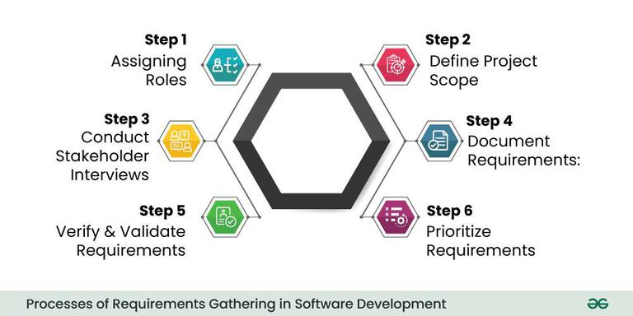
Phase 1: Requirement Collection And Analysis
it involves several subprocesses to ensure a comprehensive understanding of the project's needs. The main subprocesses include:

Slide 15
Phase 2: Feasibility study
A feasibility study is designed to reveal whether a project/plan is feasible
There are mainly five types of feasibility checks:
Economic: Can we complete the project within the budget or not?
Legal: Can we handle this project as cyber law and other regulatory frameworks/compliances?
Operation feasibility: Can we create operations that is expected by the client?
Technical: Need to check whether the current computer system can support the software
Schedule: Decide whether the project can be completed within the given schedule or not.

Slide 16
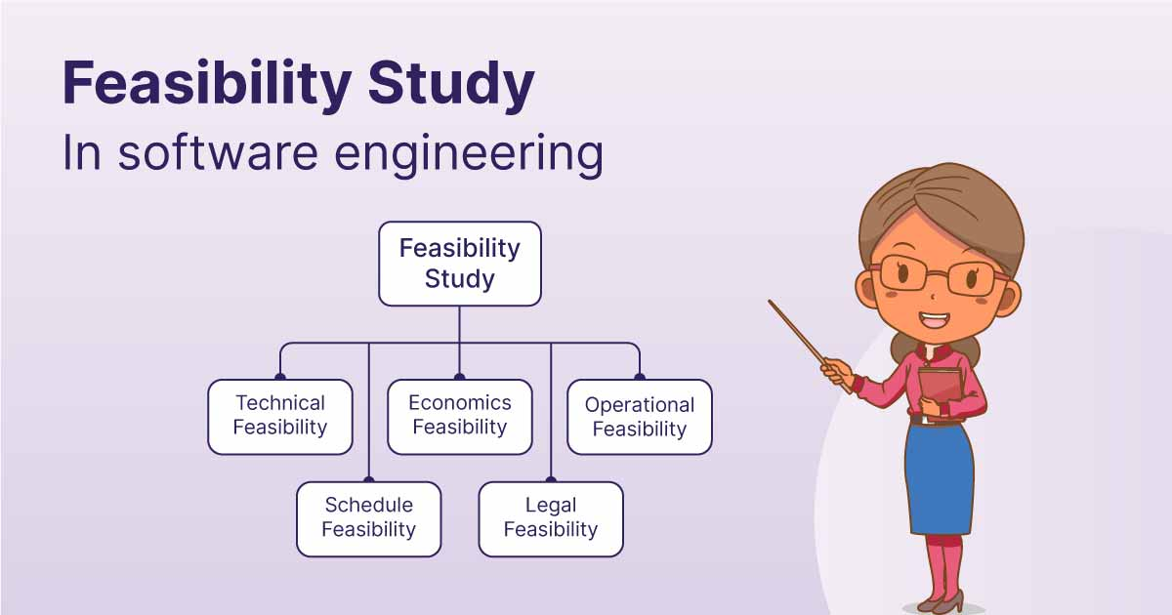
Phase 2: Feasibility study

Slide 17
Phase 3: Design
In this third phase, the system and software design documents are prepared as per the requirement specification document. This helps define overall system architecture.
This design phase serves as input for the next phase of the model.
There are two kinds of design documents developed in this phase:

Slide 18
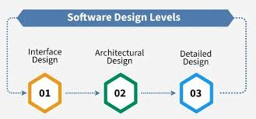
Phase 3: Design
The Design Phase of software development deals with transforming the customer requirements as described in the SRS(Software Requirement Specification) documents into a form implementable using a programming language. The software design process can be divided into the following three levels or phases of design:

Slide 19
Software Development/Coding
This is the longest phase where the actual building takes place. Developers write code based on the Design Document.
Activities: Coding, Code Reviews, Unit Testing, and Static Code Analysis.
Tools: Compilers, Debuggers, IDEs (VS Code, IntelliJ), Version Control (Git).
Output: Source Code, Executable Software.
Key Players: Developers (Frontend, Backend, Full Stack).

Slide 20
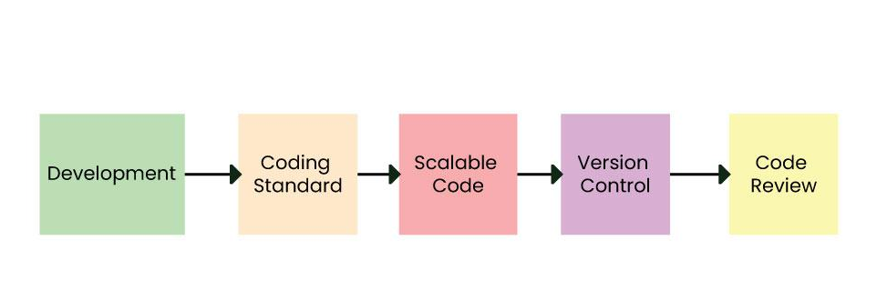
Software Development/Coding

Slide 21
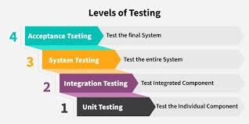
Phase 5: Testing
The Software Testing Life Cycle (STLC) is a process that verifies whether the Software Quality meets the expectations or not. STLC is an important process that provides a simple approach to testing through the step-by-step process, which we are discussing here. Software Testing Life Cycle (STLC) is a fundamental part of the Software Development Life Cycle (SDLC).

Slide 22
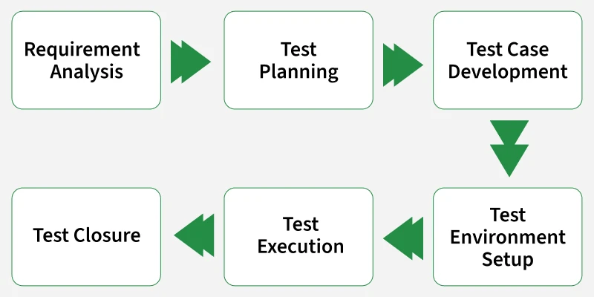
Software Testing Life Cycle (STLC)
There are six major phases of the Software Testing Life Cycle (STLC) that we are discussing here in detail.

Slide 23
Phase 6: Installation/Deployment
Software deployment is the process of making a software application available for use. It encompasses a series of activities, from preparing the software for release to installing and configuring it on target systems. The primary objective is to transition the software from the development environment to a production environment while ensuring its functionality and performance meet user expectations.

Slide 24
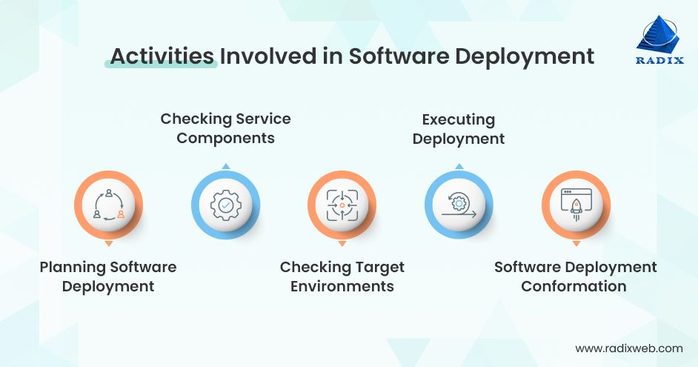
Phase 6: Installation/Deployment

Slide 25
4
Maintenance
Once the system is deployed, and customers start using the developed system, following 3 activities occur
Bug fixing – bugs are reported because of some scenarios which are not tested at all
Upgrade – Upgrading the application to the newer versions of the Software
Enhancement – Adding some new features into the existing software
The main focus of this SDLC phase is to ensure that needs continue to be met and that the system continues to perform as per the specification mentioned in the first phase.

Slide 26
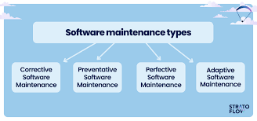
Maintenance Types
.
Software engineers classify maintenance into the following four types of software maintenance

Slide 27
Summary
The Software Development Life Cycle (SDLC) is a structured process used by development teams to design, build, test, and maintain high-quality software efficiently and cost-effectively. SDLC divides the software development process into distinct phases, each with specific goals and deliverables, ensuring systematic progress and continuous improvement.

Slide 28
Quiz/ FAQ’s
What are the main phases of the SDLC?
Why is the SDLC important in software engineering?
What is the purpose of the maintenance phase in SDLC?

Slide 29
Faculty-curated videos, NPTEL, Coursera, LinkedIn, or other relevant learning resources
NPTEL — “Software Engineering” course from IIT Kharagpur / Indian Institutes https://onlinecourses.nptel.ac.in/noc25_cs108/preview?utm_source=chatgpt.com
CS & IT Tutorials by Vrushali — “SE 1: Learn Software Engineering from Scratch” (YouTube) https://www.youtube.com/watch?v=IHx9ImEMuzQ
nptelhrd (IIT/Bombay) — Lecture series “Introduction to Software Engineering” (free video lecture) https://www.youtube.com/watch?v=Z6f9ckEElsU&utm_source=chatgpt.com
Coursera – Introduction to Software Engineering (IBM) https://www.coursera.org/learn/introduction-to-software-engineering

Slide 30
Next lecture
Agile software development and Their characteristic

Slide 31

Class-Wise Feedback

Slide 32
Thank You
For queries
Email: geeta.e15227@cumail.in

